Slide 1
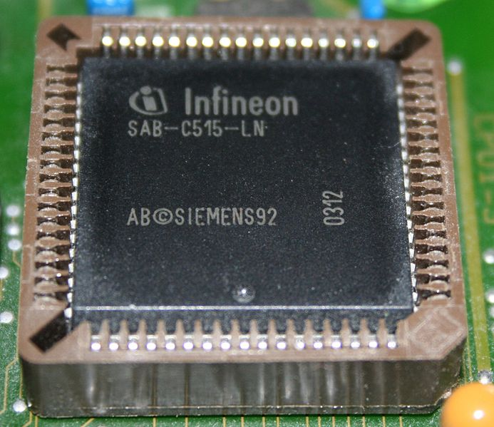
Study of 8051 microcontroller and its architecture:

Slide 2
Three criteria in Choosing a Microcontroller
meeting the computing needs of the task efficiently and cost effectively
speed, the amount of ROM and RAM, the number of I/O ports and timers, size, packaging, power consumption
easy to upgrade
cost per unit
availability of software development tools
assemblers, debuggers, C compilers, emulator, simulator, technical support
wide availability and reliable sources of the microcontrollers.

Slide 3
The 8051 microcontroller
a Harvard architecture (separate instruction/data memories)
single chip microcontroller (µC)
developed by Intel in 1980 for use in embedded systems.
today largely superseded by a vast range of faster and/or functionally enhanced 8051-compatible devices manufactured by more than 20 independent manufacturers

Slide 4
Block Diagram
External interrupts
On-chip ROM for program code
Timer/Counter
Interrupt Control
On-chip RAM
Timer 1
Counter Inputs
Timer 0
CPU
Bus Control
Serial Port
4 I/O Ports
OSC
P0 P1 P2 P3
TxD RxD
Address/Data

Slide 5

Comparison of the 8051 Family Members
Feature 8051 8052 8031
ROM (program space in bytes) 4K 8K 0K
RAM (bytes) 128 256 128
Timers 2 3 2
I/O pins 32 32 32
Serial port 1 1 1
Interrupt sources 6 8 6

Slide 6
Pin Description of the 8051
P1.0
1
40
Vcc
P1.1
2
39
P0.0(AD0)
P1.2
3
38
P0.1(AD1)
P1.3
4
8051
(8031)
37
P0.2(AD2)
P1.4
5
36
P0.3(AD3)
P1.5
6
35
P0.4(AD4)
P1.6
7
34
P0.5(AD5)
P1.7
8
33
P0.6(AD6)
RST
9
32
P0.7(AD7)
(RXD)P3.0
10
31
EA/VPP
(TXD)P3.1
11
30
ALE/PROG
(INT0)P3.2
12
29
PSEN
(INT1)P3.3
13
28
P2.7(A15)
(T0)P3.4
14
27
P2.6(A14)
(T1)P3.5
15
26
P2.5(A13)
(WR)P3.6
16
25
P2.4(A12)
(RD)P3.7
17
24
P2.3(A11)
XTAL2
18
23
P2.2(A10)

XTAL1
19
22
P2.1(A9)
GND
20
21
P2.0(A8)

Slide 7
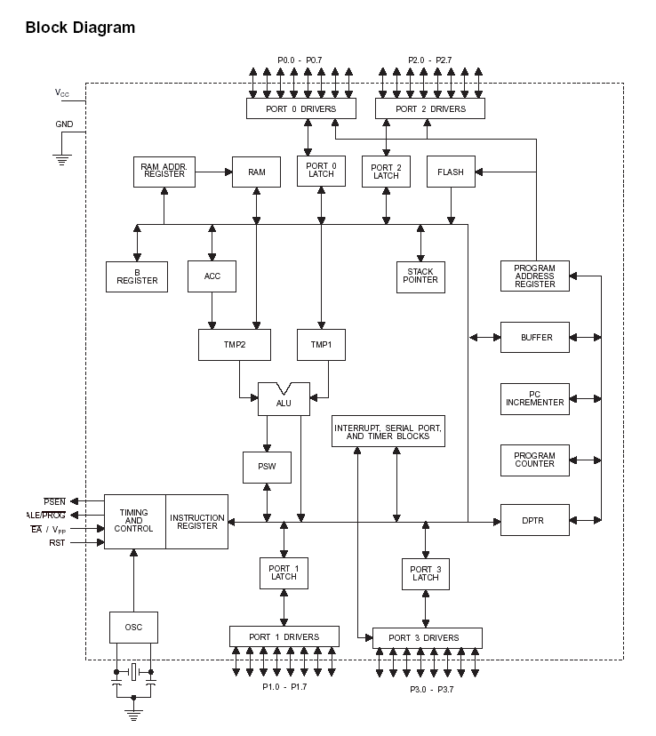

Slide 8
Pins of 8051（1/4）
Vcc（pin 40）：
Vcc provides supply voltage to the chip.
The voltage source is +5V.
GND（pin 20）：ground
XTAL1 and XTAL2（pins 19,18）：
These 2 pins provide external clock.
Way 1：using a quartz crystal oscillator
Way 2：using a TTL oscillator
Example 4-1 shows the relationship between XTAL and the machine cycle.

Slide 9
Pins of 8051（2/4）
RST（pin 9）：reset
It is an input pin and is active high（normally low）.
The high pulse must be high at least 2 machine cycles.
It is a power-on reset.
Upon applying a high pulse to RST, the microcontroller will reset and all values in registers will be lost.
Reset values of some 8051 registers
Way 1：Power-on reset circuit
Way 2：Power-on reset with debounce

Slide 10
Pins of 8051（3/4）
/EA（pin 31）：external access
There is no on-chip ROM in 8031 and 8032 .
The /EA pin is connected to GND to indicate the code is stored externally.
/PSEN ＆ ALE are used for external ROM.
For 8051, /EA pin is connected to Vcc.
“/” means active low.
/PSEN（pin 29）：program store enable
This is an output pin and is connected to the OE pin of the ROM.
See Chapter 14.

Slide 11
Pins of 8051（4/4）
ALE（pin 30）：address latch enable
It is an output pin and is active high.
8051 port 0 provides both address and data.
The ALE pin is used for de-multiplexing the address and data by connecting to the G pin of the 74LS373 latch.
I/O port pins
The four ports P0, P1, P2, and P3.
Each port uses 8 pins.
All I/O pins are bi-directional.

Slide 12
Figure 4-2 (a). XTAL Connection to 8051
GND
C2
XTAL2
30pF
C1
XTAL1
30pF

Using a quartz crystal oscillator
We can observe the frequency on the XTAL2 pin.

Slide 13
Figure 4-2 (b). XTAL Connection to an External Clock Source
NC
XTAL2
EXTERNAL
OSCILLATOR
SIGNAL
XTAL1
GND

Using a TTL oscillator
XTAL2 is unconnected.

Slide 14
RESET Value of Some 8051 Registers:
Register
Reset Value
PC
0000
ACC
0000
B
0000
PSW
0000
SP
0007
DPTR
0000
RAM are all zero.


Slide 15
Figure 4-3 (a). Power-On RESET Circuit
Vcc
+
10 uF
31
EA/VPP
30 pF
X1
19
11.0592 MHz
8.2 K
X2
30 pF
18
9
RST


Slide 16
Figure 4-3 (b). Power-On RESET with Debounce
Vcc
31
EA/VPP
X1
10 uF
30 pF
X2
RST
9
8.2 K


Slide 17
Pins of I/O Port
The 8051 has four I/O ports
Port 0 （pins 32-39）：P0（P0.0～P0.7）
Port 1（pins 1-8） ：P1（P1.0～P1.7）
Port 2（pins 21-28）：P2（P2.0～P2.7）
Port 3（pins 10-17）：P3（P3.0～P3.7）
Each port has 8 pins.
Named P0.X （X=0,1,...,7）, P1.X, P2.X, P3.X
Ex：P0.0 is the bit 0（LSB）of P0
Ex：P0.7 is the bit 7（MSB）of P0
These 8 bits form a byte.
Each port can be used as input or output (bi-direction).

Notes:
Program is to read data from P0 and then send data to P1

Slide 18
Registers
A
B
R0
DPTR
DPH
DPL
R1
R2
PC
PC
R3
R4
Some 8051 16-bit Register
R5
R6
R7
Some 8-bitt Registers of the 8051

Slide 19
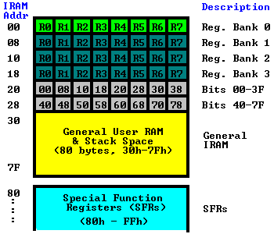
Memory Map (RAM)

Slide 20
CPU timing
Most 8051 instructions are executed in one cycle.
MUL (multiply) and DIV (divide) are the only
instructions that take more than two cycles to complete (four cycles)
Normally two code bytes are fetched from the program memory during every machine cycle.
The only exception to this is when a MOVX instruction is executed. MOVX is a one-byte, 2-cycle instruction that accesses external data memory.
During a MOVX, the two fetches in the second cycle are skipped while the external data memory is being addressed and strobed.

Slide 21
8051 machine cycle

Slide 22
Example :
Find the machine cycle for
(a) XTAL = 11.0592 MHz
(b) XTAL = 16 MHz.
Solution:
(a) 11.0592 MHz / 12 = 921.6 kHz;
machine cycle = 1 / 921.6 kHz = 1.085 μs
(b) 16 MHz / 12 = 1.333 MHz;
machine cycle = 1 / 1.333 MHz = 0.75 μs


Slide 23
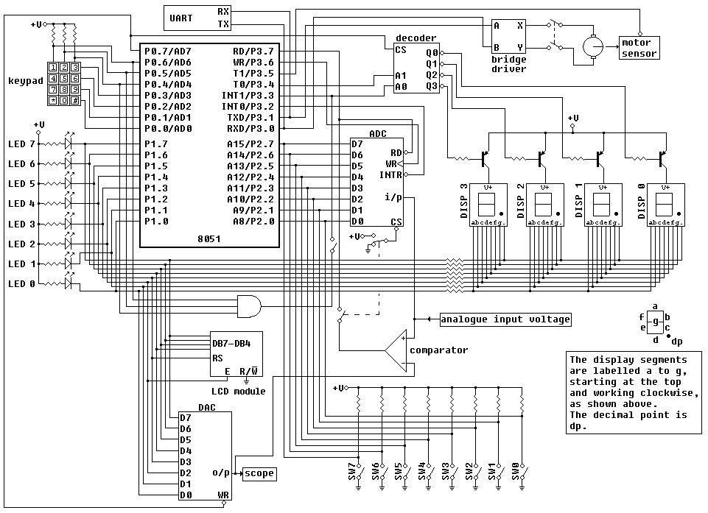
Edsim51 emulator diagram

Slide 24
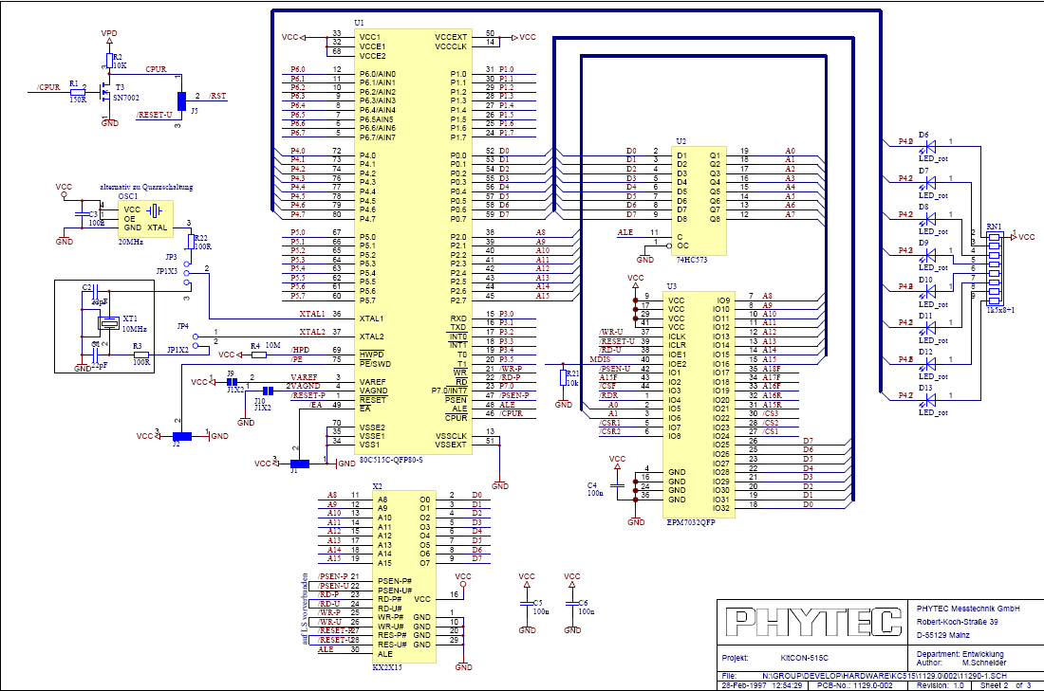
KitCON-515 schematic

Slide 25
Timers
8051 has two 16-bit on-chip timers that can be used for timing durations or for counting external events
The high byte for timer 1 (TH1) is at address 8DH while the low byte (TL1) is at 8BH
The high byte for timer 0 (TH0) is at 8CH while the low byte (TL0) is at 8AH.
Timer Mode Register (TMOD) is at address 88H

Slide 26
Timer Mode Register
Bit 7: Gate bit; when set, timer only runs while \INT high. (T0)
Bit 6: Counter/timer select bit; when set timer is an event counter when cleared timer is an interval timer (T0)
Bit 5: Mode bit 1 (T0)
Bit 4: Mode bit 0 (T0)
Bit 3: Gate bit; when set, timer only runs while \INT high. (T1)
Bit 2: Counter/timer select bit; when set timer is an event counter when cleared timer is an interval timer (T1)
Bit 1: Mode bit 1 (T1)
Bit 0: Mode bit 0 (T1)

Slide 27
Timer Modes
M1-M0: 00 (Mode 0) – 13-bit mode (not commonly used)
M1-M0: 01 (Mode 1) - 16-bit timer mode
M1-M0: 10 (Mode 2) - 8-bit auto-reload mode
M1-M0: 11 (Mode 3) – Split timer mode

Slide 28
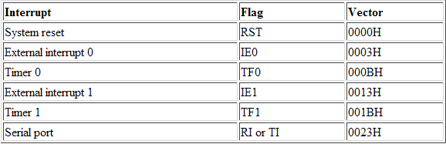
8051 Interrupt Vector Table

Slide 29
The Stack and Stack Pointer
The Stack Pointer, like all registers except DPTR and PC, may hold an 8-bit (1-byte) value.
The Stack Pointer is used to indicate where the next value to be removed from the stack should be taken from.
When you push a value onto the stack, the 8051 first increments the value of SP and then stores the value at the resulting memory location.
When you pop a value off the stack, the 8051 returns the value from the memory location indicated by SP, and then decrements the value of SP.
This order of operation is important. When the 8051 is initialized SP will be initialized to 07h. If you immediately push a value onto the stack, the value will be stored in Internal RAM address 08h. This makes sense taking into account what was mentioned two paragraphs above: First the 8051 will increment the value of SP (from 07h to 08h) and then will store the pushed value at that memory address (08h).
SP is modified directly by the 8051 by six instructions: PUSH, POP, ACALL, LCALL, RET, and RETI. It is also used intrinsically whenever an interrupt is triggered

